Slide 1

Project Title - Reducing Single-Use Plastic(Usage of Plastic Spoons)
Submitted by: Team Starks
Shiva Sai | 12212497 | K22GT36
Bilal | 12203781 | K22GT15
Nandu | 12203167 | K22GT29
Bharath | 12205425 | K22GT25
Submitted to: Pooja mam
Course Code: CSD-233

Slide 2
TABLE OF CONTENT
TOPIC | SLIDE NUMBER
INTRODUCTION | 3
WICKED PROBLEM | 4 to 6
PROBLEM FRAME | 7 to 8
AEIOU FRAMEWORK | 9 to 10
ETHNOGRAPHIC RESEARCH PLAN

Slide 3
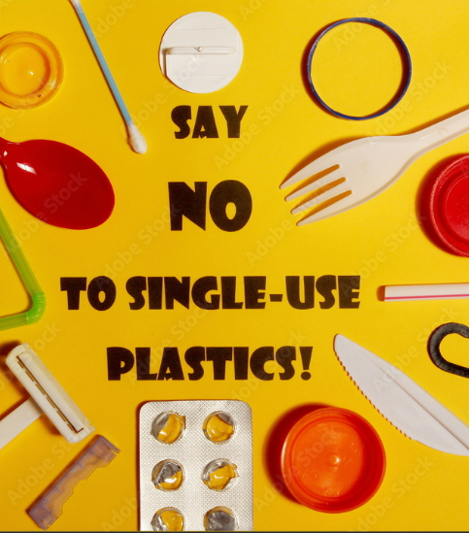
Introduction -
Single-use plastics comprise over 40% of total plastic consumption in India. The country is generating 3.5 million tons of plastic waste every year. Shockingly, only 40% of it is collected, resulting in severe pollution in rivers and urban areas. According to various research studies, plastic pollution affects more than 1,000 species. On the Indian coast alone, up to 20,000 metric tons of plastic waste are collected annually. This growing dependence on plastic has a lot more impact than just the pollution of the ecosystems. People are also exposed to increased health risks because microplastics are increasingly found in food and water supplies.
Source - Ministry of Environment, Forest and Climate Change (MoEFCC), Government of India - Regularly publishes reports and data on plastic waste management, including initiatives to reduce single-use plastics
Website: moef.gov.in

Slide 4
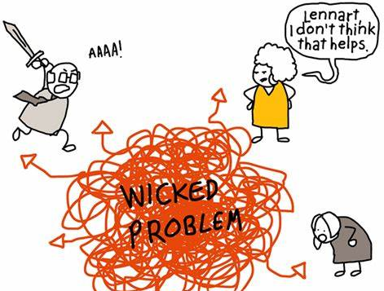
Wicked Problem
Wicked Problem is something that is not clearly defined.
It is difficult to control or stop the usage of single-use plastic
It is a wicked problem because single-use plastic is difficult to handle and impacts everything: from the environment to human health. It is cheap and convenient, so people and industries use it heavily, but it's tough to recycle and often ends up as waste. This waste pollutes land and oceans, harming wildlife and ecosystems. Because plastic takes hundreds of years to break down, it builds up over time. It would require big changes in production, habits, and waste management, thus making the issue very complex and difficult.

Slide 5
INDICATORS OF WICKED PROBLEMS
Indicator of wicked problem… | How/where we see this for the industry problem
1) No definitive formulation | There are many ways to look at the problem of single-use plastics, including that of production, consumer demand, and recycling, which causes a struggle as to which approach to go with.
2) No Stopping Rule | There are huge number of products so we can control many at maximum but not all so no end for this.
3) Solutions are not true or false, but good or bad | We will relace it with other materials like paper, might sound looking good at a first glance, but may lead to other environmental harm in increased forestation thereby showing not all solutions are equally good.
4) No immediate/ultimate test of a solution | It takes much time and quite challenging to measure its success after implementation to get better results
5) Every solution is a one-shot operation | While going with alternatives, if the consumer is not favorable to this solution, they might never use it again which stresses the problems of one-time approaches toward solutions

Slide 6
6) No enumerable set of potential solutions | There are various strategies to address but all can be controlled up to a certain amount or stage only but all completely
7) The problem is unique | The challenge faced by a beach town with tourists using single-use plastics is different from that of an urban area with better recycling facilities, highlighting how specific circumstances can influence the issue
8) The problem can be considered the symptom of another problem | This reliance on convenience can overshadow the need for more eco-friendly choices, as individuals may opt for single-use products for their simplicity rather than considering their long-term environmental impact.
9) The existence of discrepancies | Businesses may support reducing single-use plastics for marketing purposes while resisting changes due to cost, leading to conflicting views on the best approach to tackle plastic waste.
10) The planner has no right to be wrong | If a city council implements a plastic ban and it results in higher costs or issues for local businesses, the decision-makers face pressure to avoid mistakes, knowing that failures can have significant consequences.

Slide 7
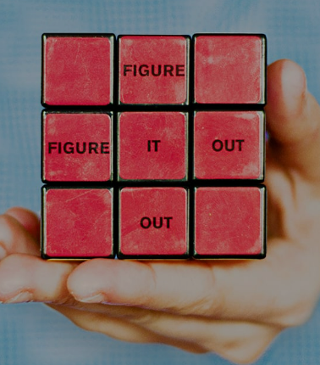
PROBLEM FRAME
What is your initial problem ‘frame’? Who’s eyes are looking at the problem through?
How might we decrease or completely eliminate the single-use plastic spoon from entering the environment, taking into consideration both the functional needs of consumers and the ecological footprint of production and waste?
The consumers, businessmen, vendors, and manufacturers are part of this.

Slide 8
What other possible frames might there be for this problem?
Health and Safety Frame Focuses on ensuring hygiene and safety standards that are usually linked to single-use plastics. Aims to create alternatives that uphold these essential qualities.
Cultural and Social Norms Frame Explores how single-use items are ingrained in the fast-paced dining culture. Seeks to change attitudes and behaviors towards more sustainable choices.
Waste Management and Recycling Infrastructure Frame Addresses the challenges of disposal and recycling for single-use plastics and their alternatives. Emphasizes the need for compatibility with current waste management systems.
Educational and Awareness Frame Increases awareness about the environmental effects of plastic spoons. Promotes behavioral changes through campaigns and informative labeling.
Lifecycle and Material Innovation Frame Looks at sustainable materials and the complete lifecycle of the spoon. Concentrates on production methods, durability, and the impact of disposal.
Economic Accessibility Frame Focuses on overcoming the cost barriers associated with sustainable alternatives. Strives to make eco-friendly spoons affordable for all consumers and businesses.
Convenience and Functionality Frame Ensures that the convenience and practicality of single-use plastic spoons are preserved. Works on developing functional, sustainable options suitable for on-the-go use.

Slide 9
AEIOU FRAMEWORK
ACTIVITIES | ENVIRONMENT | INTERACTIONS | OBJECTS | USERS
Cafes and Bakeries: preferred to eat deserts and consuming soups. | Plastic spoons are mainly found in fast-food chains where they are provide them with takeaway meals (Ex: McDonald's, KFC) | Industries interact with food service industries to produce large number of spoons according to the demand. | Kitchen Utensils for mixing up of small ingredients. | Consumers who are comfortable to use and free of cost at fast food center.
Flight & Railway Meals: provided by airlines and railway services to enjoy the meals | Widely used at large public gatherings such as marathons, sports games where catering services rely on plastic spoons. | suppliers provide plastic utensils in bulk to restaurants, event organizers with low cost. | Gardening Tools for labelling a plant or a seed. | Event organizers who consider to be easy to use and not to make place unclean with water.
Household Backups: when dishwash is not preferred to wash and to make it easy | packaged food include plastic spoons for customer convenience. | people participate in awareness campaigns which describes negative impacts of single-use plastic | Creative material for Sculptures and decorations. | Employees/ workers who are working in companies .

Slide 10
ACTIVITIES | ENVIRONMENT | INTERACTIONS | OBJECTS | USERS
Office lunches: To complete meal in a given period especially during lunch breaks | Households uses plastic spoons for convenience during casual gatherings and for kid’s parties. |  | Used for painting or craft and art | Teachers uses plastic spoons for classroom activities allowing students to engage in hands-on learning experiences.
Fast-food center: Primary location for single-use plastic spoons, especially for takeout orders.
Events: used at events, parties, and picnics for convenience.

Slide 11

ETHNOGRAPHIC RESEARCH PLAN

Slide 12
What are the sights/people that you are planning to study?
-Manufacturers: Companies such as RATAN IMPLEX and MR.PLAST manufactures single use plastic spoons. They may need to do something new alternatives by exploring sustainable materials that do not affect the environment.(ex wooden spoons)
-Food Outlets: Fast-food centers and cafés provide plastic spoons along with the order. Consumer habits may influence how demand affects choices to use eco-friendly products. (ex: price)
-Consumers: Regular use of plastic spoons in takeaways and delivery. We will explore their preferences for convenience, awareness of environment and ways for alternative materials.
-Waste Collection Workers: -Members involved in collection and storing of waste(mainly plastic) . They explain the challenges of recycling plastic spoons and where most of the waste end up. (separation of different kinds of plastic)
- Environmental Activities and Organizations: Groups working to make environmental sustainable by various methods. They advocate public to use reusable/eco-friendly products and make them aware how single-use plastic affect the environment.

Slide 13
How do the sites you have chosen(or have access to) impact your research questions?
These people can provide best inputs of entire life-cycle of single use plastic
-Spoon manufacture companies understand challenges they faced while adopting eco-friendly products. This shows why plastic spoons are still in demand even availability of sustainable products is more.
-Observing and interviewing food outlets shows how often customers use plastic spoons. we can understand if they allow sustainable products how importantly these are presented to influence customers for eco-friendly materials.
-waste collection members who involved in collection and storing plastic helps us to understand and explain the challenges of recycling plastic (separation of different kinds of plastic)
-Environmental activities and organizations share insights of the challenges they face in promoting to use sustainable practices. Their ideas helps us to shift for eco-friendly alternatives.
What kind of relationship did you hope/plan to establish with your research subjects?
Our aim is to maintain collaborative and respectful relationship and ensure they feel comfortable to share their honest reviews. We plan to have trust and empathy when discussing environmental impacts on using plastic spoons. We will approach each conversation with more focused by respecting their perspectives and thought process.

Slide 14
How did you plan to collect and organise data?
We like to collect data through
Observations: visit food outlets to observe how spoons are provided to customers and if possible sustainable alternatives are available and how customers reactions to these options.
Interviews: conducting interviews with food outlets/cafe managers, consumers. This will help to focus on challenges that are facing to adopt eco-friendly materials and motives for choosing sustainable products.
Surveys: conducting surveys with the large number of consumers to identify the usage and the awareness on the environment.
What do you learn from your ethnographic research?
Consumers:
-I learned that consumers who are convenience of using plastic spoons without thinking much about the environmental impact even they are aware of the impact.
-Even who aware of sustainable products still favour to use quick and disposable option mainly in food outlets.
-price of sustainable products will play major role. As the cost of plastic spoons are cheaper compared to sustainable one so they prefer to use plastic over eco-friendly.

Slide 15
What do you need to be aware of when writing about your findings?
Context: need to communicate about environmental issues of using single-use plastic, framing the findings and need to explain how this matter for both consumer and environment.
Confidentiality: respecting the privacy of interviewer mainly who likely to share their personal opinion.
Balance: mention both challenges and opportunities for eco-friendly practices by taking acknowledgement from manufacturers, food outlets, consumers
What academic materials were relevant to this process?
Study on environmental sustainability and consumer behaviour related to single use plastic which provide information why people show interest to choose convenience over sustainability.

Slide 16

INTERVIEW PLAN

Slide 17
INTERVIEW QUESTIONS
During what situations do you tend to use plastic spoons, for instance, are they used during parties, take out food, have a picnic?
What makes it easy to use plastic spoons when there are other options that are reusable. What are the considerations (e.g., convenience, cost, availability)?
Do you know that plastic cheeseburgers are a textbook example of using disposable plastic spoons? Do you think this affects your actions in any way?
What problems do you encounter when you try to use greener options (shock price, inconvenience, hard to find)?
What would you use in place of plastic spoons if they were no longer in use?
In a typical day, how often do your customers purchase disposable plastic spoons compared to wooden or reusable ones?
Do you feel that there has been any change in the purchase of plastic single use items over time?
In your opinion, how do the costs, availability, or desire for an eco-friendly replacement of plastic spoons impact sales or promotion of such products?
Could you reduce sales of the plastic spoons if the demand for the substitutes was greater and provided there was enough market competition?
How in your opinion do you see the sales of the single-use plastic spoons progressing over the years?
In your transition towards utilizing more eco-friendly products, what constraints do you face, such as cost or technology. How about market demand?
What, if anything, is your company doing to lessen the ecological consequences of your products?
In your opinion what innovations practical or technological would have to evolve to make the eco-friendly options more practical in the market?

Slide 20

What do they HEAR?
-warning about the environmental impacts of plastic by media and environmental advocates
-marketing messages from businesses that encourage sustainable choices.
Who are we empathizing with:
People who prefer priority to use convenience and ease such as dinners, takeaway customers, and events.
GOAL:
-aim to minimize their environmental cause
-seek alternatives that balance convenience and sustainability.
-quick and disposable utensils without the need for cleaning.
What do they need to DO?
-make easy and quick decisions that fit into their busy lifestyle.
-considering reducing single-use plastic consumption if alternatives are available
-choose products that benefit from both convenience and environmental needs
Hearing
Empathy Map
Seeing
What do they SEE?
-limited options for eco-friendly products, depending on location and price.
-Awareness and signs in certain places promote sustainable choices.
What do they SAY?
-just one spoon, how much impact does it have on the environment
-It is convenient but I don’t feel what impact it has on the environment
pAINS
gAINS
Worry about contributing for plastic waste and environmental harm
Frustration when sustainable materials are expensive or unable to find/get
Worry about long term impact on marine life and the Earth
Convenience to use and no need to wash and carry
Relief when they find products that are eco friendly
Reduce guilt as they feel responsibility got fulfilled

Slide 21
Journey Map
Scenario: An employee orders lunch at the office canteen that comes along with a single-use plastic spoon
Step1
Step2
Step3
Step4
take convenient utensils to enjoy his meal
Decide to eat lunch
Employee finishes meal and looks to dispose of them.
Employee reflets on lunch experience
GOAL: to get a meal during break without hassle.
DOES: -receive take order along with the plastic spoon
-consider the convenience of having a meal with plastic.
-feel confident to use plastic but do not want to waste his time
OPPORTUNITIES:
-encourage restaurants to provide sustainable utensils
-offer reusable utensils to people to use
GOAL: enjoy a meal during break comfortably.
DOES:
-use a plastic spoon to eat
-consider to bring own reusable utensils next time
-guilt on environmental impact.
OPPORTUNITIES:
-provide a spot for reusable utensils in the office
-can distribute reusable utensils as part of the employee welcome kit.
Goal: dispose of utensils without causing harm to the environment.
DOES:
-look for the trash bin.
-frustration if no proper disposal is available
OPPORTUNITIES:
-can set labeled recycling and compost bins in the office.
-option for employees to return reusable utensils for cleaning.
GOAL: feel positive about their break time
DOES:
-leave the place by feeling guilty of using plastic spoons.
-think thoughts about sustainability about their colleagues.
-worry about making eco-friendly in the future.
OPPORTUNITIES:
-implement feedback for employees to share experiences.
-reward options for employees for consistent use odd sustainable options
-Share success stories who made eco-friendly

Slide 22
USER PERSONA 1
Persona name:
Age:
Job:
Personality:
Goals / Motivations:
Wants/Needs:
Picture

Slide 23
USER PERSONA 2
Persona name:
Age:
Job:
Personality:
Goals / Motivations:
Wants/Needs:
Picture

Slide 24
USER PERSONA 3
Persona name:
Age:
Job:
Personality:
Goals / Motivations:
Wants/Needs:
Picture

Slide 25
5-Whys TECHNIQUE
WHY | Question | Response
1 | why do you usually go for plastic spoons instead of, like, a reusable one? | its comfortable to use and low cost
2 | Why do you think being green is less important than convenience and cost? | reusables or biodegradable spoons feel like too pricey to use compared to plastic one.
3 | Why its cheap compared to what? | Compared to wooden or biodegradable spoons it is cheap because of materials they use in manufacturing.
4 | Why is it that biodegradable spoons are so much more expensive to produce? | Biodegradable products require certain processes and materials, so its expensive compared to plastic one.
5 | Why don’t you consider wooden spoons or alternatives? | It is not available everywhere and higher in price.

Slide 26
Thank you
Brita Tamm
502-555-0152
brita@firstupconsultants.com
www.firstupconsultants.com

